Slide 1




END-SEM EVALUATION
FakeTweet Busters
A combination of BERT and Deepfake detection to resolve the spreading of fake AI generated news
Shubhangee Pal
Bhagyashree Das
Amrisha Das
Under Supervision of
Dr. Preeti Kaur

Slide 2


Introduction
Project merges BERT text analysis with deepfake detection for accurate fake tweet identification.
Synergizing these technologies creates a comprehensive framework, empowering users and platforms against sophisticated online misinformation.
Let’s begin!

Slide 3


motivation
1
2
The Global Crisis of Fake News
Advanced Detection Techniques
The global surge in fake news, with over 70% of internet users encountering it, poses severe risks to public perception, electoral processes, and societal harmony.
A study revealed over 60% inability to distinguish real from deepfake videos, emphasizing the urgency for advanced detection methods addressing both textual and visual manipulation.

Slide 4
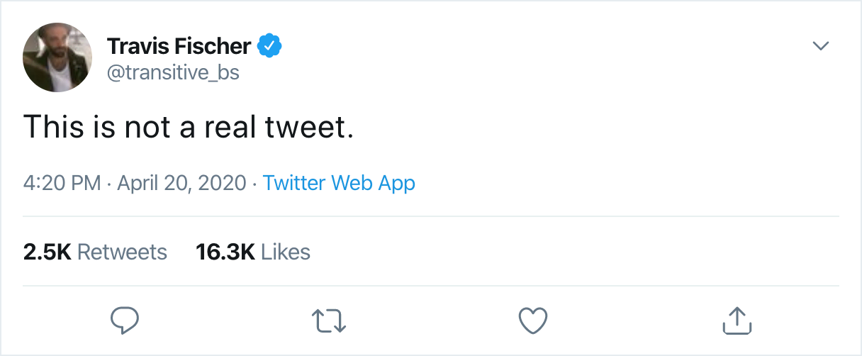

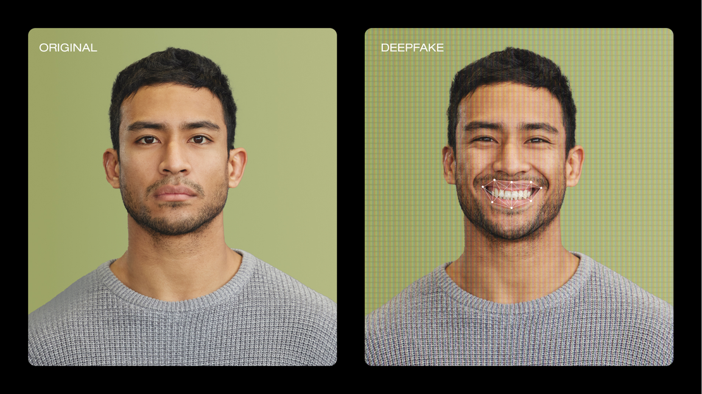
Problem Statement
Rising fake news, especially in manipulated tweets, challenges online integrity. Conventional methods lack visual context. We propose a robust solution combining BERT text analysis and advanced deepfake detection for accurate detection.

Slide 5
2. Understanding the concept of BERT and other technologies
3.Understanding the concept of Deepfake
4.Comparing the different techniques to get the suitable model for identifying fake textual content
5.Building a basic Deepfake detection model for identifying fake images
1. Viewing the Research Papers
6.Building a model which incorporates both textual, visual input in single go
Along with audio input separately
workflow
Notes:
Building a model which incorporates both textual and visual input in single go

Slide 6
WORKING
The main aim was to compare different language models, techniques, LLM’s such that we can conclude which will serve the best to meet our needs.
Fake tweet detection
(initial approach)
BoW
(Bag of Words)
CharCNN
(Character-Level Convolutional Neural Network )
BERT
(Bidirectional Encoder Representations from Transformers)

Slide 7
WORKING
The main aim was to compare different language models, techniques, LLM’s such that we can conclude which will serve the best to meet our needs.
Fake tweet detection
(initial approach)
RoBERTa
DistilBERT
XLNet

Slide 8
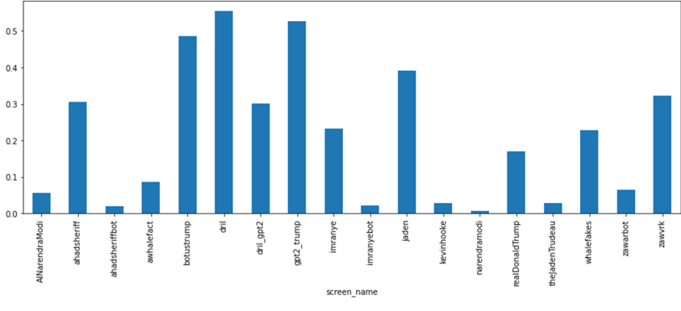
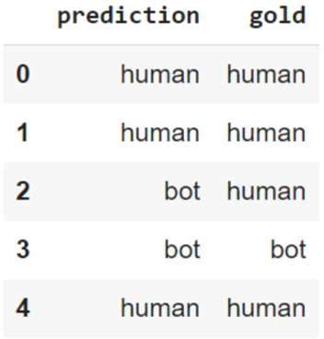
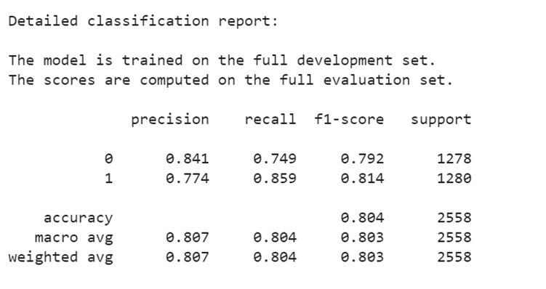
RESULTS
for textual detection
(our initial model)

Slide 9
Face Detection and Analysis
using MTCNN
and InceptionResNetv1
Visualization and Prediction
using Grad-CAM and confidence score
User friendliness
using Gradio Interface
WORKING
Detecting deepfakes in images involves utilizing various techniques to identify inconsistencies or manipulation artifacts introduced during the creation process.
Deepfake Detection
For visual data (images)

Slide 10
Conversion from time domain to frequency domain
using FT and STFT
Mel Spectrogram
Visualization
.
using mel filterbank
Evaluation
using SVM model
WORKING
Detecting deepfakes in images involves utilizing various techniques to identify inconsistencies or manipulation artifacts introduced during the creation process.
Deepfake Detection
For auditory data (audio files)

Slide 11


Technologies Used
BERTweet
BERT
CharCNN
BoW
BERT
Roberta
XLNet
DL
CV
GANs
Albert
ML
FT/STFT

Slide 12

WORK DONE TILL NOW
Visual Content Inspection
TEXTUAL ANALYSIS
Deepfake Detection
ata.
Multimodal Fusion

Slide 13
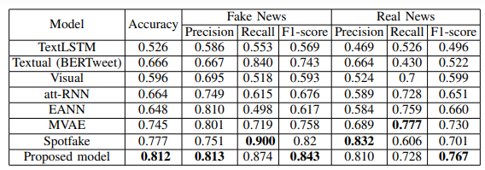
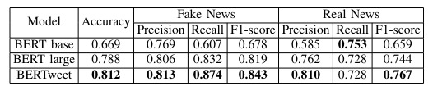
RESULTS
for textual detection
(our current model)

Slide 14
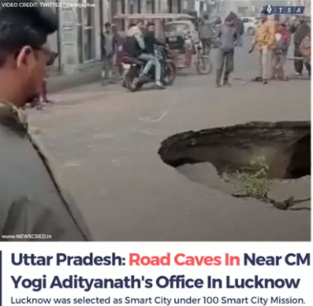


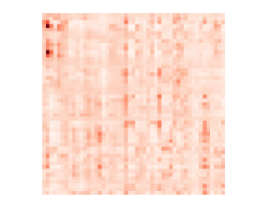
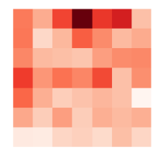
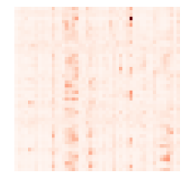

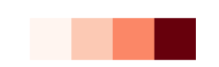
RESULTS
for textual detection
(our current model)
(REAL IMAGE)
(FAKE IMAGE)

Slide 15
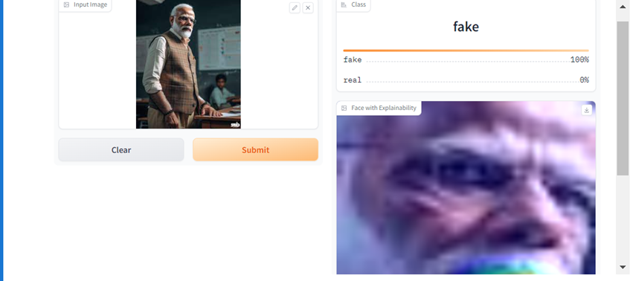


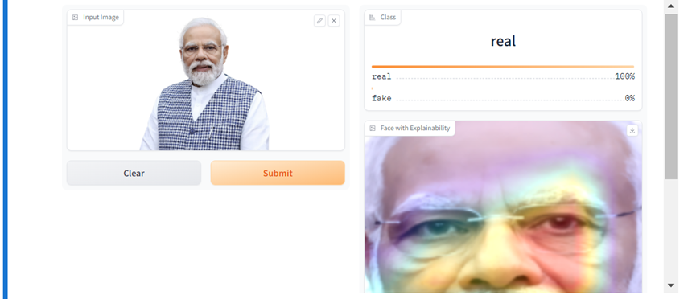
RESULTS
for visual data

Slide 16
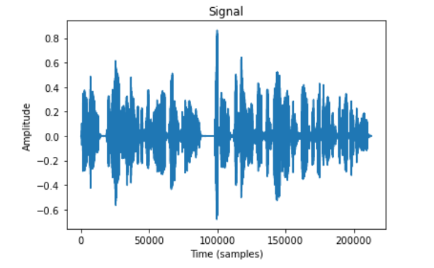
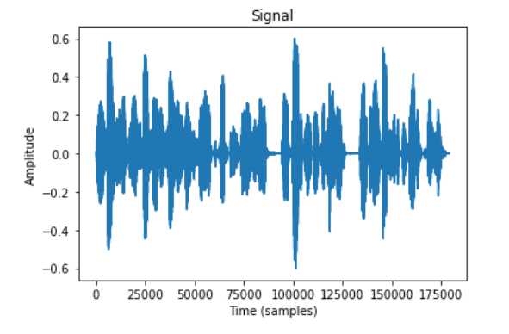
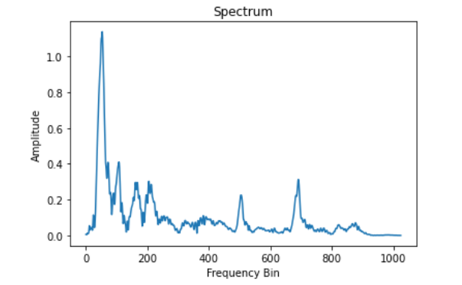
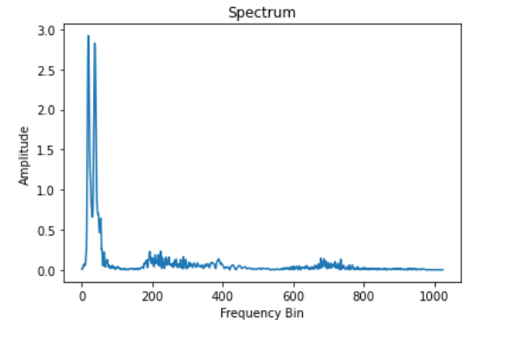
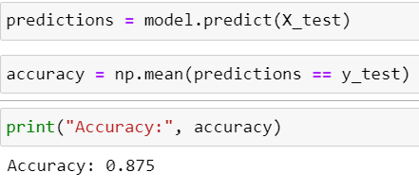
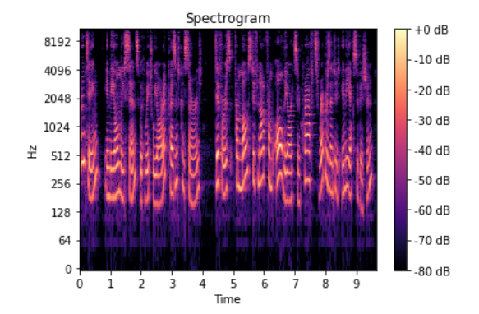
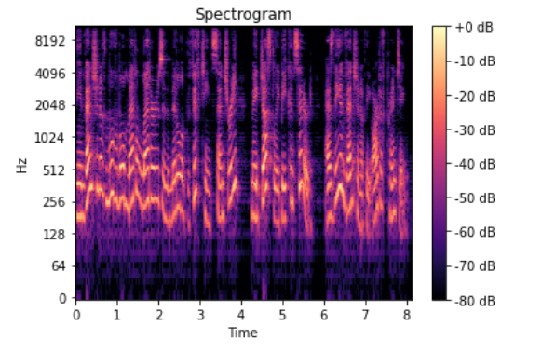
RESULTS
for auditory data

Slide 17
FUTURE SCOPE
Enhanced Multimodal Analysis
. Real-Time Detection
Improving the multimodal analysis by incorporating more sophisticated techniques for text and image analysis
Develop a system capable of real-time fake tweet detection
Incorporating Deepfake Video Analysis
. Fine-Grained Analysis
Working more in depth on Deepfake detection for audio and video files.
Going beyond binary classification of fake vs. genuine to perform fine-grained analysis, such as identifying the specific types of manipulation present in fake tweets
Integration with
Social Media Platform
Partner with social media platforms to integrate the fake tweet detection system into their
existing infrastructure

